Slide 1

My Company - Calico Gateway API
Month Year
Presented by Solutions Architect

Slide 2
Kubernetes’ Native Limitations
Ingress Features
Legacy Ingress API vs Gateway API
Calico Ingress Gateway

Slide 3
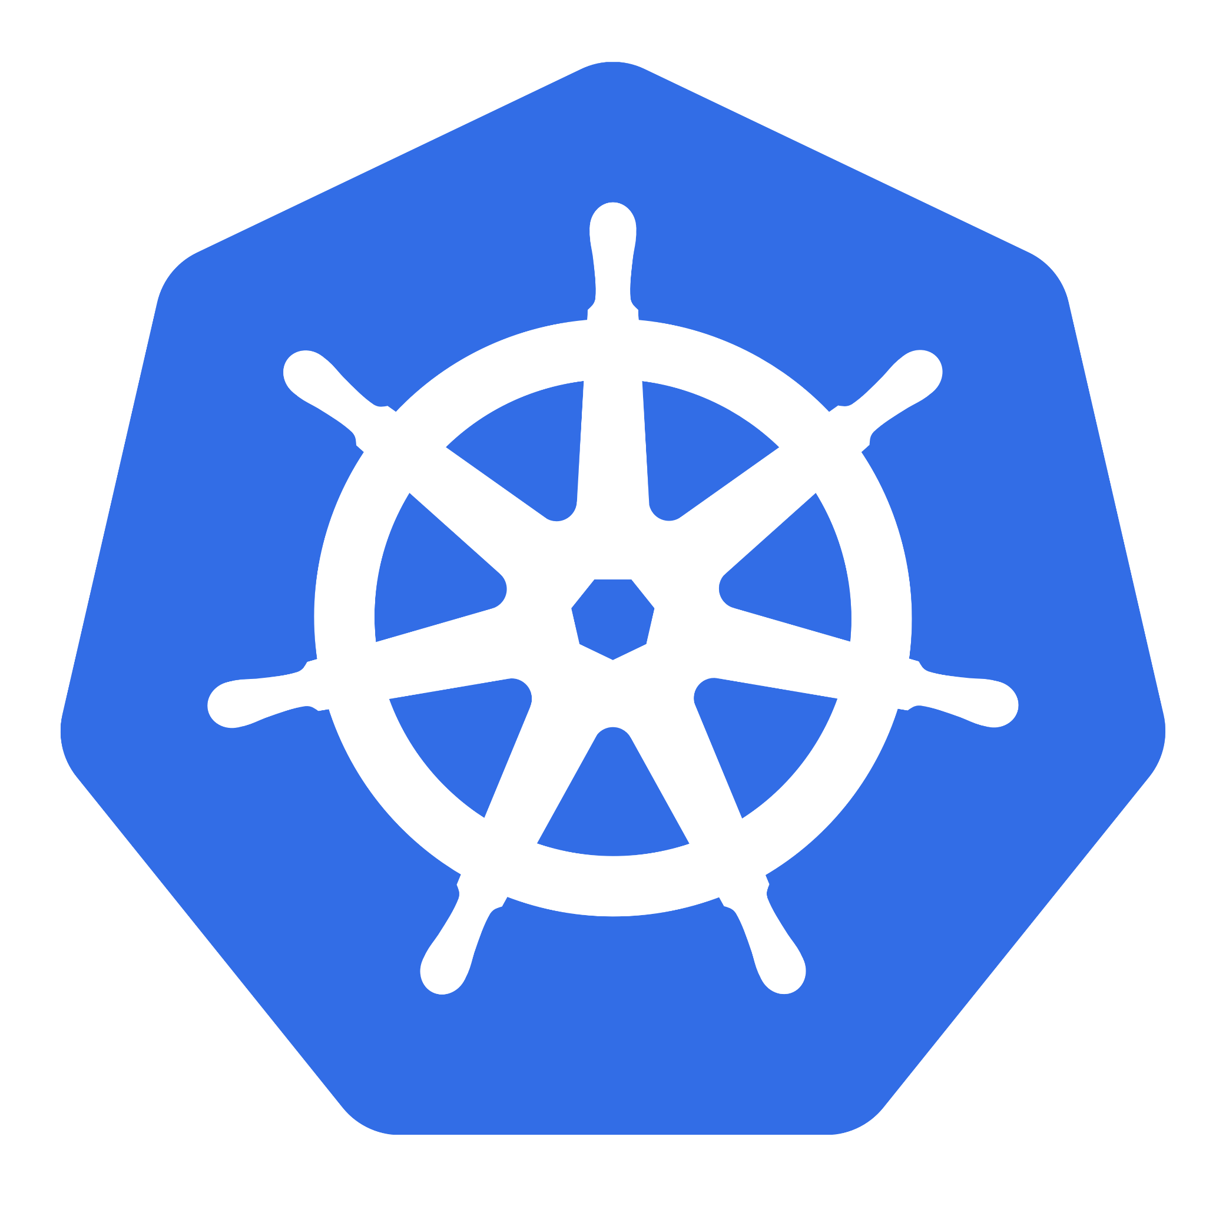


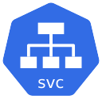
Why Kubernetes Needs an Ingress Controller
Kubernetes provides three core service types for exposing apps:
ClusterIP
NodePort
LoadBalancer
Each solves a piece of the puzzle, but gaps remain.
Internal-only access
No HTTP-aware routing
Manual TLS management
Cluster IP
Notes:
Kubernetes is powerful, but out-of-the-box, it has critical gaps for real-world traffic management:
External Access limited
Exposing apps requires workarounds like NodePort.
ClusterIP services are internal-only.
Load Balancers.
Lack of HTTP/S Traffic Rules
Kubernetes doesn’t natively understand ‘route /api to service A’—you’d need custom code or sidecar proxies.
TLS Certificate Chaos
Without Ingress, every app must manage its own SSL certs. No central TLS termination.
Vendor Lock-in
Load Balancers are expensive, vendor locked-in
Relying on AWS ALB or GCP LB ties you to that cloud. Migrating becomes painful.
On Premises, Load Balancers are not only costly in money but in time and skills to integrate them in the network fabric.
Transition to Next Slide: So how do we solve this? Enter Ingress Controllers for Kubernetes traffic.

Slide 4
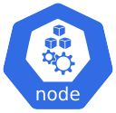
Why Kubernetes Needs an Ingress Controller
Kubernetes provides three core service types for exposing apps:
ClusterIP
NodePort
LoadBalancer
Each solves a piece of the puzzle, but gaps remain.
Exposes apps on a static port (30000-32767) on every node.
Security risks
Open firewall rules for high ports.
No load balancing
Clients must handle node failures
Port conflicts
Only one service per port across the cluster
NodePort
Notes:
Kubernetes is powerful, but out-of-the-box, it has critical gaps for real-world traffic management:
External Access limited
Exposing apps requires workarounds like NodePort.
ClusterIP services are internal-only.
Load Balancers.
Lack of HTTP/S Traffic Rules
Kubernetes doesn’t natively understand ‘route /api to service A’—you’d need custom code or sidecar proxies.
TLS Certificate Chaos
Without Ingress, every app must manage its own SSL certs. No central TLS termination.
Vendor Lock-in
Load Balancers are expensive, vendor locked-in
Relying on AWS ALB or GCP LB ties you to that cloud. Migrating becomes painful.
On Premises, Load Balancers are not only costly in money but in time and skills to integrate them in the network fabric.
Transition to Next Slide: So how do we solve this? Enter Ingress Controllers for Kubernetes traffic.

Slide 5

Why Kubernetes Needs an Ingress Controller
Kubernetes provides three core service types for exposing apps:
ClusterIP
NodePort
LoadBalancer
Each solves a piece of the puzzle, but gaps remain.
Cloud or Vendor specific
Requires AWS/GCP/Azure.
Needs Integration On-prem.
Costly and wasteful
Provisions one LB per service ($$$).
Still no HTTP features
L4 (TCP) only unless using cloud-specific add-ons.
Load Balancer
Notes:
Kubernetes is powerful, but out-of-the-box, it has critical gaps for real-world traffic management:
External Access limited
Exposing apps requires workarounds like NodePort.
ClusterIP services are internal-only.
Load Balancers.
Lack of HTTP/S Traffic Rules
Kubernetes doesn’t natively understand ‘route /api to service A’—you’d need custom code or sidecar proxies.
TLS Certificate Chaos
Without Ingress, every app must manage its own SSL certs. No central TLS termination.
Vendor Lock-in
Load Balancers are expensive, vendor locked-in
Relying on AWS ALB or GCP LB ties you to that cloud. Migrating becomes painful.
On Premises, Load Balancers are not only costly in money but in time and skills to integrate them in the network fabric.
Transition to Next Slide: So how do we solve this? Enter Ingress Controllers for Kubernetes traffic.

Slide 6



Why Kubernetes Needs an Ingress Controller
So how do we solve this?
Enter Ingress Controllers the Swiss Army knife for Kubernetes traffic.
Requires a Load Balancer but can be used for as many services you need.
Single entrypoint for all HTTP/S traffic.
Portable (works anywhere K8s runs)
Rich features (TLS, routing, auth, etc.)
Load Balancer
Notes:
Kubernetes is powerful, but out-of-the-box, it has critical gaps for real-world traffic management:
External Access limited
Exposing apps requires workarounds like NodePort.
ClusterIP services are internal-only.
Load Balancers.
Lack of HTTP/S Traffic Rules
Kubernetes doesn’t natively understand ‘route /api to service A’—you’d need custom code or sidecar proxies.
TLS Certificate Chaos
Without Ingress, every app must manage its own SSL certs. No central TLS termination.
Vendor Lock-in
Load Balancers are expensive, vendor locked-in
Relying on AWS ALB or GCP LB ties you to that cloud. Migrating becomes painful.
On Premises, Load Balancers are not only costly in money but in time and skills to integrate them in the network fabric.
Transition to Next Slide: So how do we solve this? Enter Ingress Controllers for Kubernetes traffic.

Slide 7
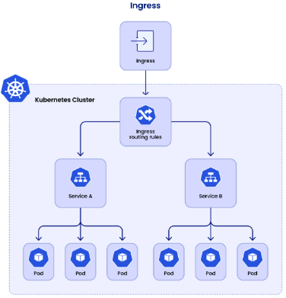
Ingress Features: Solutions for Business
External Access Management
Kubernetes Service (ClusterIP) is internal-only; Ingress exposes HTTP/HTTPS routes externally.
Traffic Routing Rules
Path-based routing (/api → backend-service), host-based routing (app.example.com).
TLS Termination
Handles SSL/TLS certificates (e.g., via Let’s Encrypt with cert-manager).
API Gateway Features
Rate limiting, authentication, request rewriting.
Standardization vs. Cloud LBs
Avoids cloud-specific Load Balancers (AWS ALB, GCP LB) for portability.
Notes:
Seamless External Access
Expose apps securely without overpaying for cloud LBs or integrating to On-premises network.
Business Impact: Faster time-to-market, reduced infra costs.
Smart Traffic Routing
Prefix Path-based (/checkout → cart-service) routing.
Business Impact: Cleaner microservices, better user experience.
Centralized TLS & Security
Automate SSL certs with cert-manager. Enforce HTTPS globally.
Business Impact: Compliance (PCI DSS), customer trust.
API Gateway Capabilities
Rate limiting (prevent abuse), OAuth/JWT (secure APIs), request rewriting (legacy app support).
Business Impact: Scalable, secure APIs for partners/customers.
Multi-Platform Portability
Run the same Ingress rules on AWS, GCP, or on-prem.
Business Impact: No vendor lock-in; negotiate better cloud deals."*
Closing Hook:
"And Calico’s Ingress Gateway takes this further let’s dive into how it leverages Envoy for even more power."

Slide 8
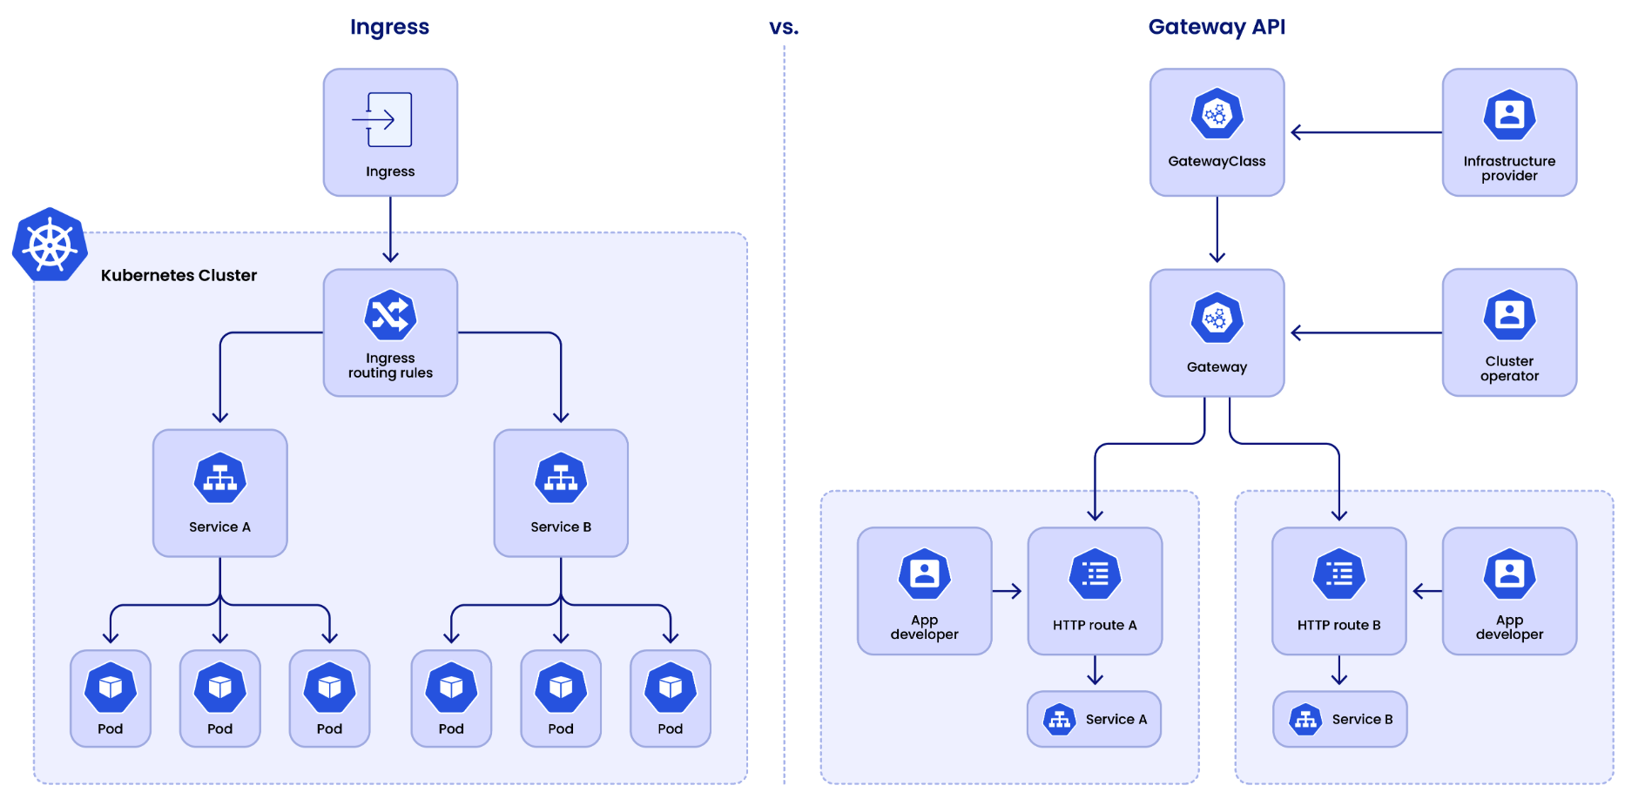
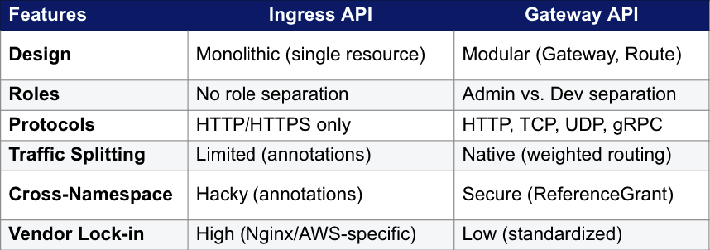
Legacy Ingress API vs Gateway API
Notes:
Why Gateway API?
Future-proof: CNCF-standard, replacing Ingress long-term.
Multi-role: Platform teams manage infra; devs manage routes.
Advanced L4/L7: Supports TCP/UDP, gRPC, and mesh integration.

Slide 9
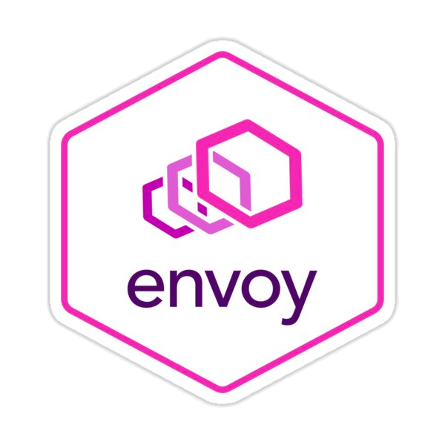

Calico Ingress Gateway
Envoy-Based Foundation
Powered by Envoy Proxy: Leverages Envoy’s battle-tested L7/L4 data plane for high performance and observability.
Gateway API-Native: Implements Kubernetes Gateway API standards (e.g., HTTPRoute, TCPRoute).
Extensions for Production (CRDs)
Traffic Control: ClientTrafficPolicy, BackendTrafficPolicy (timeouts, retries).
Security: SecurityPolicy (mTLS, WAF integration).
Extensibility: EnvoyExtensionPolicy (Wasm filters, custom logic).
Production-Grade Features
Traffic Management: Rate limiting, canary releases, circuit breaking.
Security: TLS termination, OIDC authentication, DDoS protection.
Observability: Metrics (Prometheus), logs, and distributed tracing.
Powered by Envoy Proxy Leverages Envoy’s battle-tested L7/L4 data plane for high performance and observability.
Gateway API Native Implements Kubernetes Gateway API standards (e.g., HTTPRoute, TCPRoute).
Exposes Advanced Features via custom policies Traffic Control: ClientTrafficPolicy, BackendTrafficPolicy (timeouts, retries). Security: SecurityPolicy (mTLS, WAF integration). Extensibility: EnvoyExtensionPolicy (Wasm filters, custom logic).

Slide 10
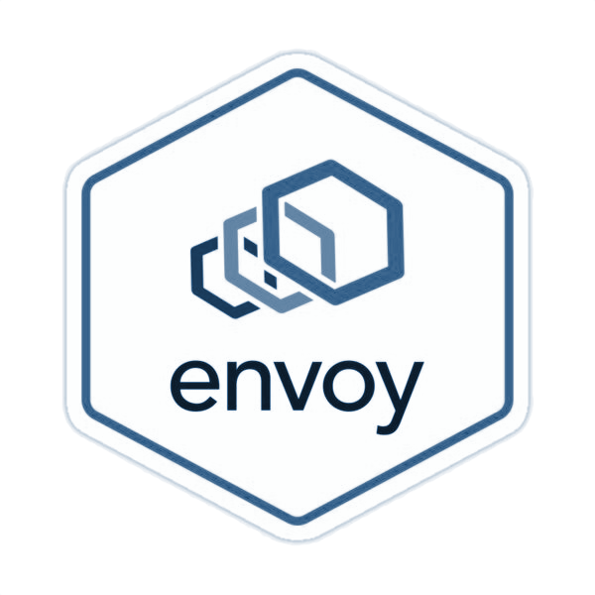

Calico Ingress Gateway
Tigera - Creator and Maintainer of Calico
Backed by Tigera’s enterprise support, professional services, and deep engineering expertise for Calico’s Envoy Gateway.
Leverage custom GatewayClasses for granular control
Custom GatewayClasses let you tailor gateway behavior (e.g., rate limiting, access control) to your infrastructure’s specific needs.
Combine traffic mirroring with traffic splitting for safer deployments
Combine traffic mirroring + splitting in HTTPRoute to safely test new versions before full rollout.
Use Gateway API for multi-cluster setups
Deploy Gateway API across clusters for centralized, scalable multi-cluster traffic management.
Powered by Envoy Proxy Leverages Envoy’s battle-tested L7/L4 data plane for high performance and observability.
Gateway API Native Implements Kubernetes Gateway API standards (e.g., HTTPRoute, TCPRoute).
Exposes Advanced Features via custom policies Traffic Control: ClientTrafficPolicy, BackendTrafficPolicy (timeouts, retries). Security: SecurityPolicy (mTLS, WAF integration). Extensibility: EnvoyExtensionPolicy (Wasm filters, custom logic).

Slide 11
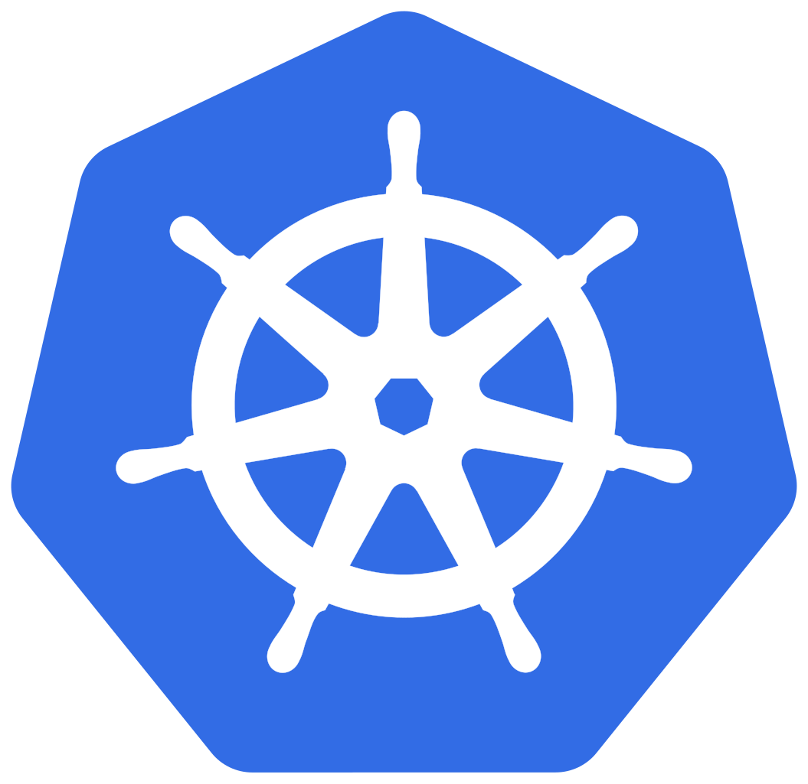

What is Calico Ingress Gateway?
Tigera operator
Cluster Operator
Deploys
HTTP GET https://calico.org/cats/v1
Inspect
Calico Ingress Gateway
Cats V1
External User
Route
Match
Policy
Configure
Cats App Developer

Slide 12
Our Implementation
kind: GatewayAPI
apiVersion: operator.tigera.io
metadata:
name: tigera-secure
spec:
… customizations …
Envoy Gateway
(implementation)
Official k8s Gateway API
CRDs
EnvoyGateway extra
CRDs
Calico Ingress Gateway requires a proxy to route to external traffic according to rules hence the use of Envoy Proxy
Envoy Gateway Controller
Notes:
Envoy Gateway is not in the dataplane.
More like a control plane for http traffic.
Envoy Gateway and Proxy is battle hardened, standardized and very customisable.

Slide 13
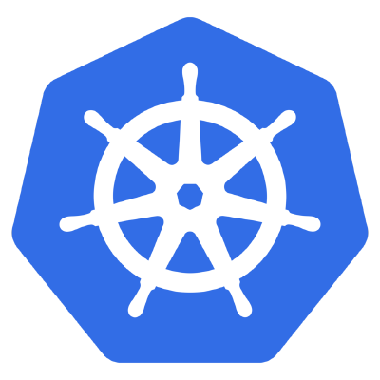
Calico Ingress Gateway Roadmap
Today
Tomorrow
External Traffic
Calico Ingress Gateway
Envoy Gateway
Envoy Gateway
WAF
Observability
Gateway Management
Support
Support
catalog
product
customer

Slide 14
Thank you

